Slide 1
Workflow mapping (practical)
Which of my tasks should be a rule, an AI step or an agent?
Applied AI and Automation | Session 12 of the 15 (Sessions 0 to 14)
KLAi Professional Learning | Jotham Martin Wambi
Notes:
Welcome to Session 12, the first of three practical sessions. Last time, in Session 11, we watched an agent work inside written permissions, with human-in-the-loop approval before anything that cannot be undone. Today the mode changes. For eleven sessions I mostly demonstrated and you watched. From today you do the work, on one task of your own, from work or the summary of your own email, and I work beside you.
We map it, decide what kind of help each step needs, and estimate the hours you could save. Our question is this: which of my tasks should be a rule, an AI step or an agent?

Slide 2



Today in one view: what you will leave with
By the end of today you will have
A map of one workflow of your own: trigger, steps, handoffs and the check
A choice for every step (rule-based automation, AI step, agent or person) and a sketch of a personal assistant
A baseline and an hours-saved estimate in the Business Case Workbook, with net benefit, payback period and ROI
Notes:
You answer that question for your own work, and you leave with three things made by your own hand. A map of one workflow of your own: what starts it, the steps, the handoffs and the check. A choice for every step: rule-based automation, an AI step, an agent or a person, with a sketch of a personal assistant if one fits.
And a baseline and an hours-saved estimate in the Business Case Workbook, with the net benefit, payback period and ROI. The clock shows how much of today is yours.

Slide 3
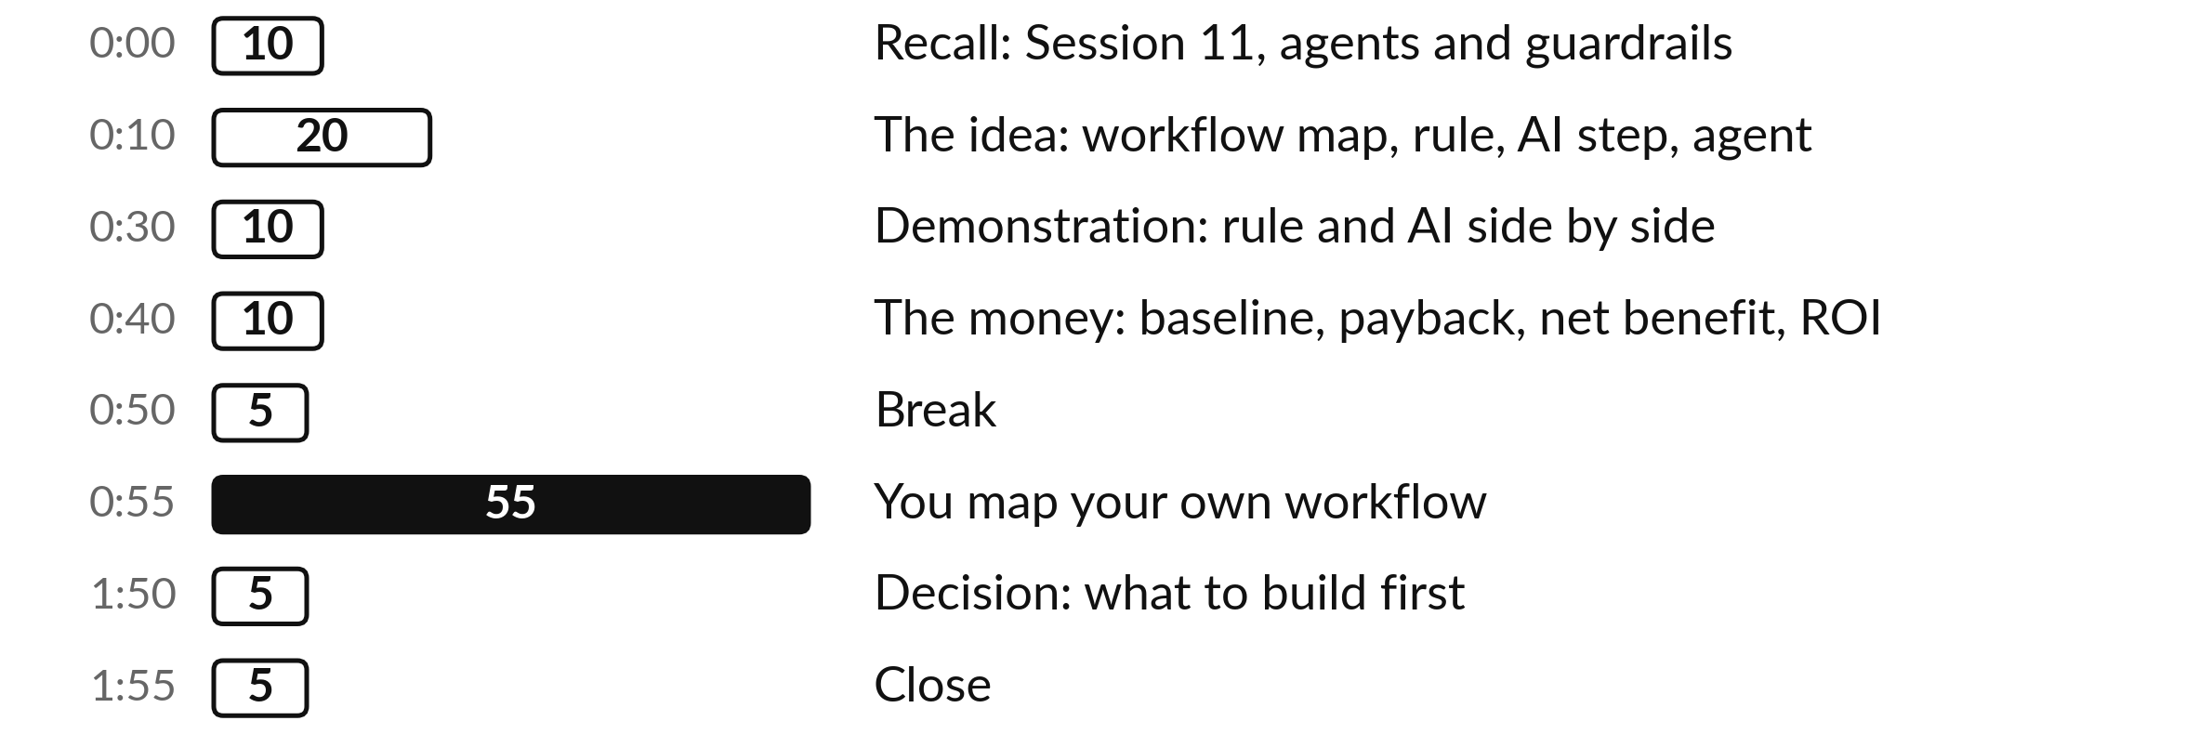
Your two hours: 55 minutes
are your own workflow
Most of today is your own work, with me at your side.
Notes:
This is the first practical, and the clock shows it. After ten minutes of recall, twenty minutes on the idea: a workflow and its map, then three kinds of machine help, rule-based automation, an AI step and an agent, each explained before we compare them, and a sketch of a personal assistant.
Ten minutes of demonstration: a recorded AI sort and a keyword rule on the same twelve messages. Ten minutes on the money, built step by step on a kettle: baseline, payback period, net benefit and ROI. Then, after a short break, fifty-five minutes on your own workflow, and five for a decision. First, the recall.

Slide 4

Three questions from last time
1. What are the three steps of the agent loop?
2. Which four kinds of action must always wait for human-in-the-loop approval?
3. What are the four rows of the Tool Boundary Sheet, the permissions table?
Answer aloud first. Then we check together.
Notes:
Three quick questions from Session 11. Answer aloud first, and then we check together. It is a warm-up to bring last time back.
Question one. What are the three steps of the agent loop? Take a moment.
A good answer is this. Plan the next step, act by calling one tool, observe the result, and repeat until the goal is met or a stop condition fires.
Question two. Which four kinds of action must always wait for human-in-the-loop approval? Say it to yourself first.
A good answer is this. Sends, payments, deletions and commitments such as accepting a price.
Question three. What are the four rows of the Tool Boundary Sheet, the permissions table? Think about your own work as you answer.
A good answer is this. Read, write, send and spend. For each: what it may do, what a person approves and what it must never do.
If an answer was missing, last session’s take-away sheet or workbook page has it. Now to today.

Slide 5
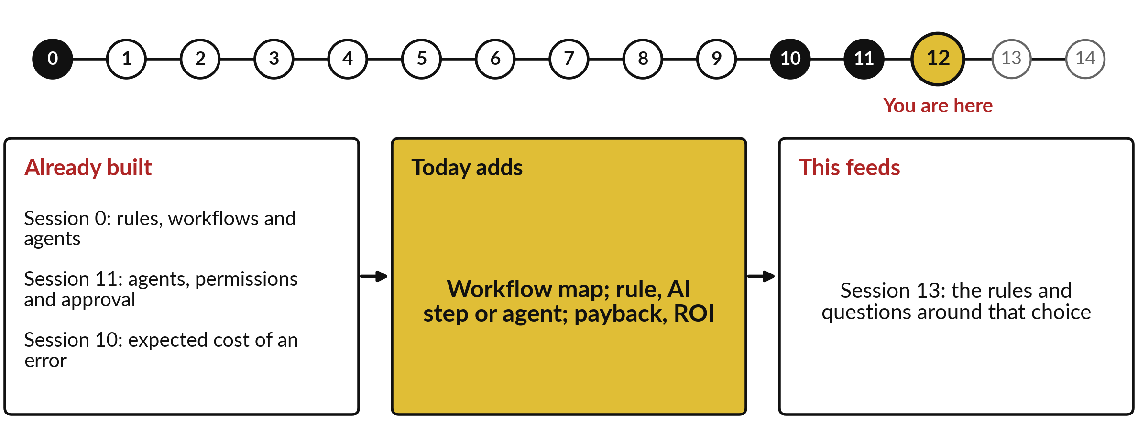
How today connects: what we
already have and what it feeds
Each session is built on the ones before it.
Notes:
So where does today sit in the story? The dots along the top are the fifteen sessions, from the map at Session 0 to your plan at Session 14, and the gold one is today.
We already hold rules, workflows and agents from Session 0, agents, permissions and approval from Session 11 and expected cost of an error from Session 10. Nothing today starts from zero.
What today adds is this: workflow map; rule, AI step or agent; payback, ROI.
And it feeds straight into what comes next. Session 13: the rules and questions around that choice. Keep that chain in mind, because each idea you learn today is a step on it.

Slide 6




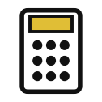

Words we use today
Word | What it means
Workflow map | A drawing of a repeated task: one lane per person, a box per step, arrows for order and handoffs, from trigger to check.
Rule-based automation | A machine runs fixed rules with no judgement, such as a bank standing order.
AI step | One call to a model that makes a judgement, such as spam or not spam, inside a fixed path.
Baseline | Time, cost and errors of the task today, measured before any change. (In Session 3: a score to beat.)
Payback period | How long until the savings repay the one-off cost: one-off cost divided by net saving a month.
Return on investment (ROI) | Net benefit (benefits minus costs) divided by costs, times 100 percent, over a stated period.
Notes:
6 words for today. I give the plain meaning of each, and we use every one of them before the end of the session.
Workflow map. A drawing of a repeated task: one lane per person, a box per step, arrows for order and handoffs, from trigger to check.
Rule-based automation. A machine runs fixed rules with no judgement, such as a bank standing order.
AI step. One call to a model that makes a judgement, such as spam or not spam, inside a fixed path.
Baseline. Time, cost and errors of the task today, measured before any change. (In Session 3: a score to beat.)
Payback period. How long until the savings repay the one-off cost: one-off cost divided by net saving a month.
Return on investment (ROI). Net benefit (benefits minus costs) divided by costs, times 100 percent, over a stated period.
Keep those words close. The first idea uses them straight away, so let us begin.

Slide 7
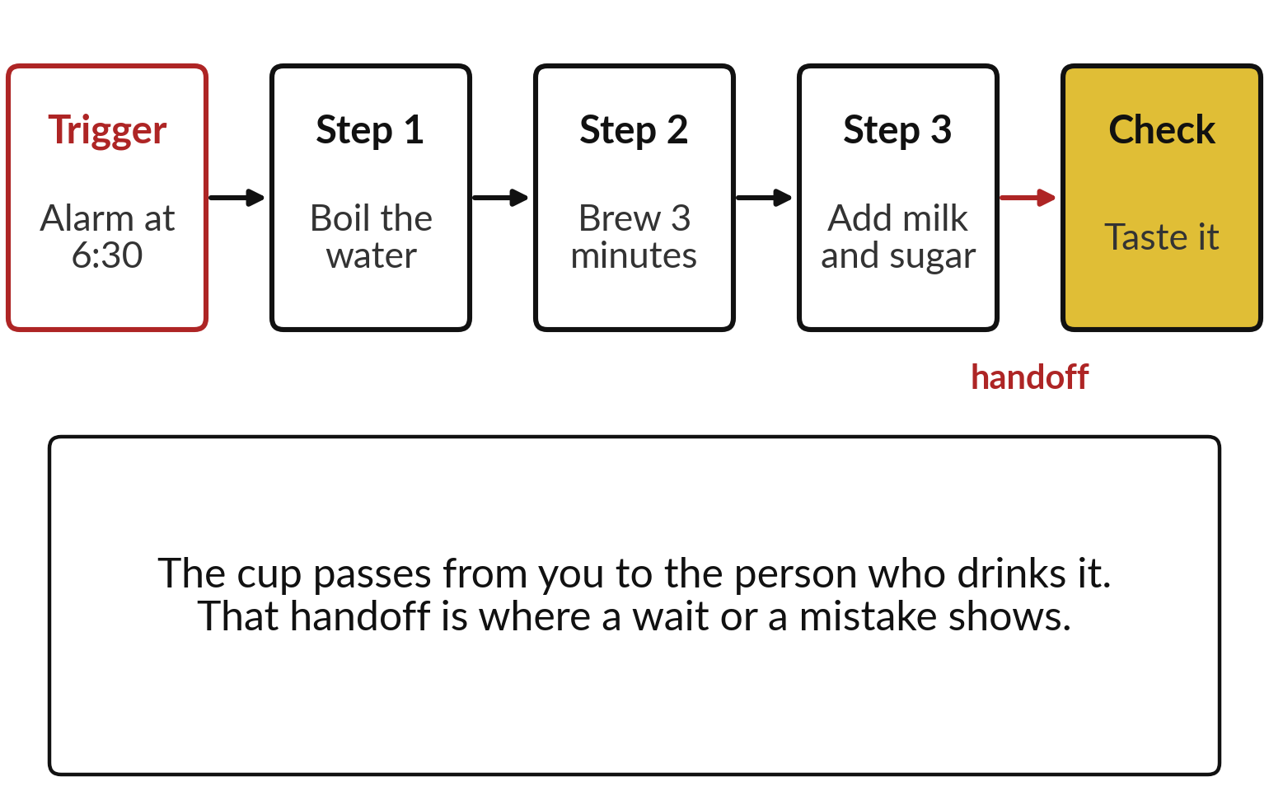
Everyday first: making tea is a workflow
with a trigger, steps, a handoff and a check
A workflow is a task that repeats. It has four parts.
Trigger: what starts it.
Steps: what is done, in order.
Handoff: where work changes hands.
Check: who confirms the result.
Notes:
Of today’s words, workflow is the one the session hangs on, so we start with one you know: making morning tea. The trigger is the alarm at half past six. Then the steps, in order: boil the water, brew for three minutes, add milk and sugar. Then a handoff: the cup passes from you to the person who drinks it, so the work changes hands.
And the check: they taste it. If the tea is cold, the delay was probably at that handoff. Every workflow, at home or at work, has the same four parts: trigger, steps, handoffs and a check. Four parts are easier to see when you draw them, so let me draw this one.

Slide 8
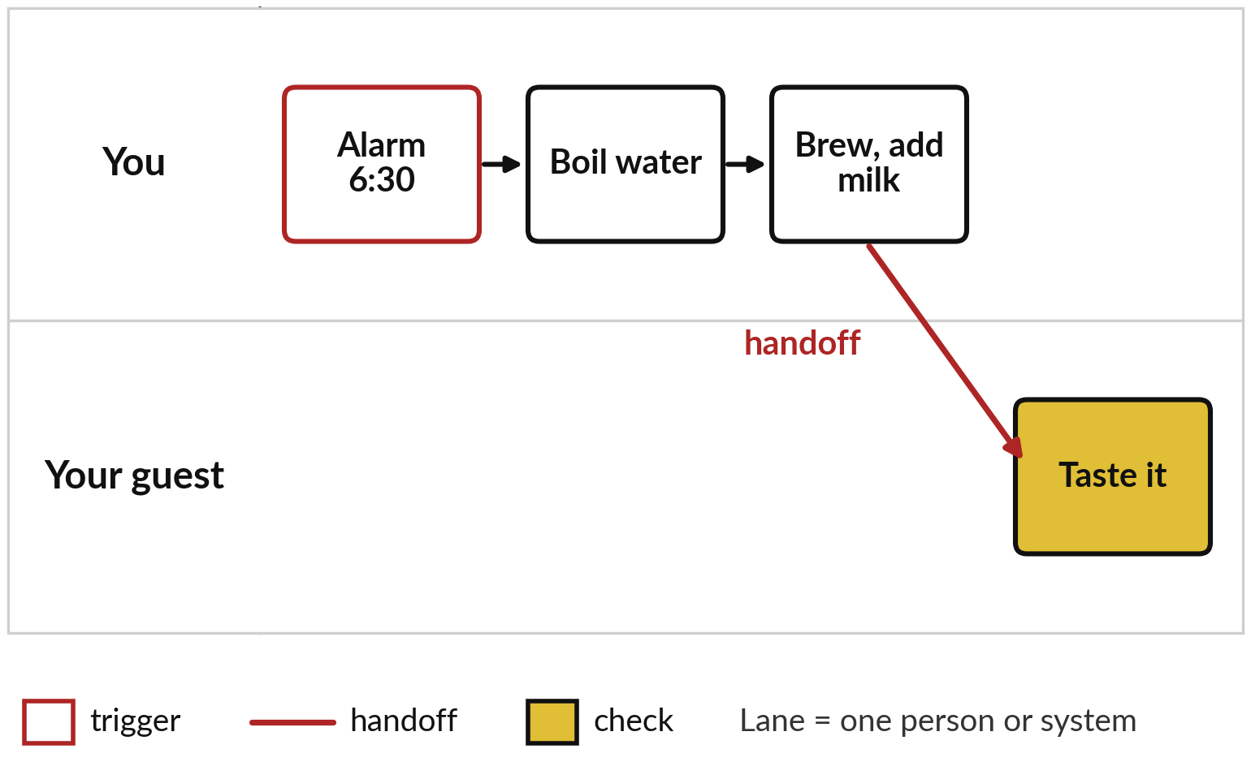
A workflow map draws the workflow: one
lane for each person, a box for each step
A workflow map is a drawing that shows who does each step, in order.
Lane: one row for each person or system.
Box: one step. Arrow: the order.
Red arrow: a handoff crosses lanes.
Notes:
That drawing is called a workflow map: a picture of a workflow that shows who does each step and in what order. Here is the same tea. Each person gets a lane, a row across the page: one for you, one for your guest. Each step is a box in the lane of whoever does it, and arrows show the order.
The alarm, the trigger, has a red edge. Boiling and brewing stay in your lane. Then the cup crosses into your guest’s lane: that red arrow is the handoff. The check, tasting, is gold. Industry also calls this a swim-lane diagram. The same drawing works at work, with more lanes.

Slide 9
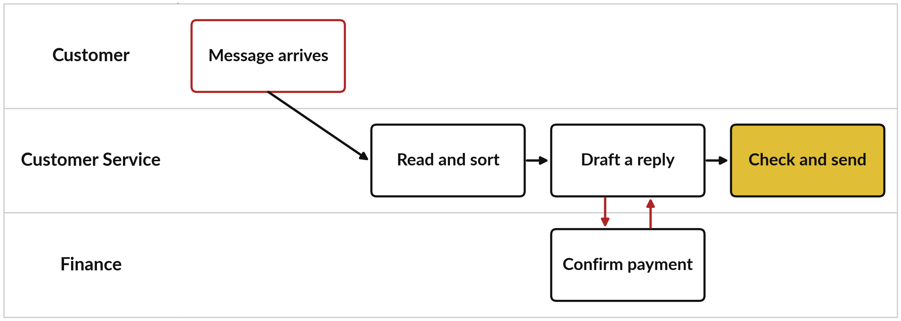
Where you see it at work: customer
messages at Nile Valley Foods in three lanes
One lane per person or team. Red arrows are handoffs: Customer Service waits for Finance.
Notes:
Here is a finished map from our case company, drawn exactly like the tea. A customer message is a short text, such as an order, a payment notice or a complaint, and the company wants each one answered by the right team. There are three lanes: the customer, Customer Service and Finance.
The trigger, in red, is a customer message arriving. Customer Service reads and sorts it, then drafts a reply. When money is involved, the draft waits for Finance to confirm the payment: that handoff and its return are the red arrows. Finally a person checks and sends. Every box on this map needs someone or something to do it.
So who, or what, should do each box?

Slide 10
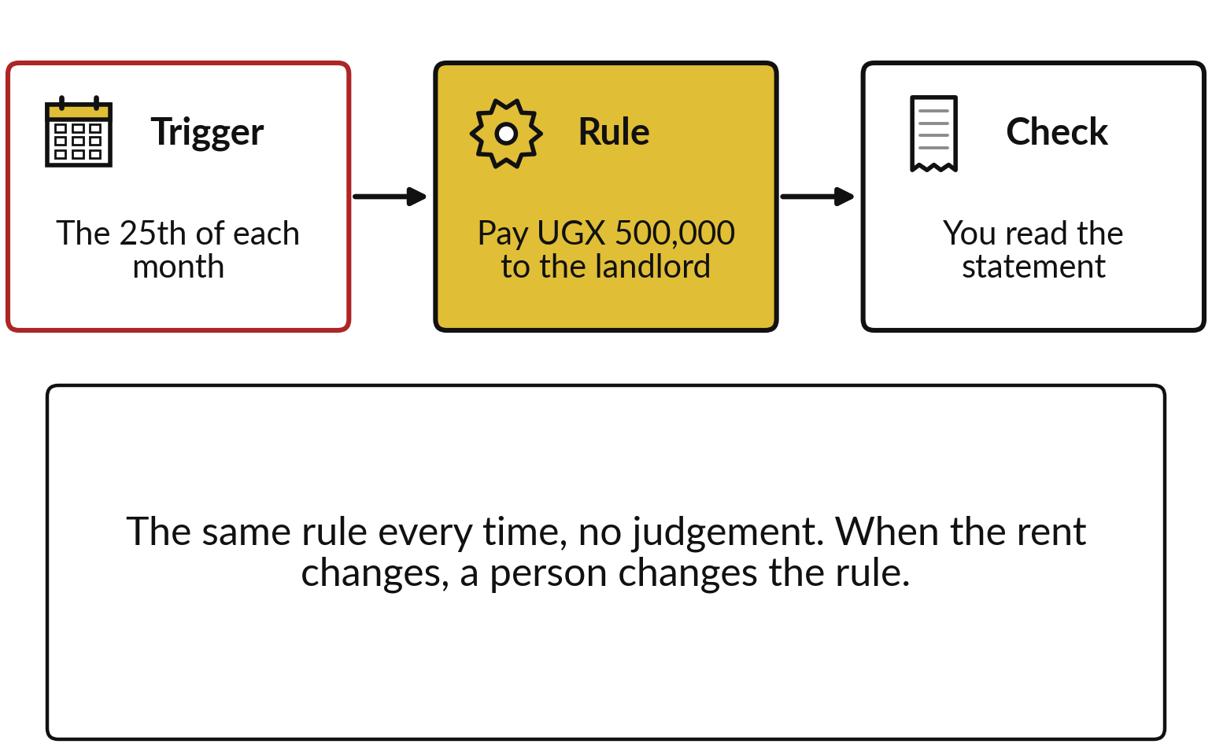
The first kind of machine help is rule-based
automation: a bank standing order
Automation: a machine runs the steps when the trigger fires. Rule-based automation follows fixed rules.
Trigger: the 25th of each month.
Rule: pay UGX 500,000 to the landlord.
Check: you read the statement.
Notes:
To answer that, recall Session 0. It showed three kinds of machine help on one ladder: rule-based automation, a fixed path with one AI step, and an agent. Today I explain each before we compare them. Automation means a machine carries out the steps when the trigger fires, without you.
The simplest kind is rule-based automation: fixed rules with no judgement. A bank standing order is a good example. The trigger is a date, the twenty-fifth of each month. The rule is fixed: pay UGX 500,000 to the landlord. The bank never decides whether the landlord deserves it.
Your part is the check, reading the statement, and when the rent changes, you change the rule. Rules suit steps decided by clear words or numbers. But many steps need judgement.

Slide 11
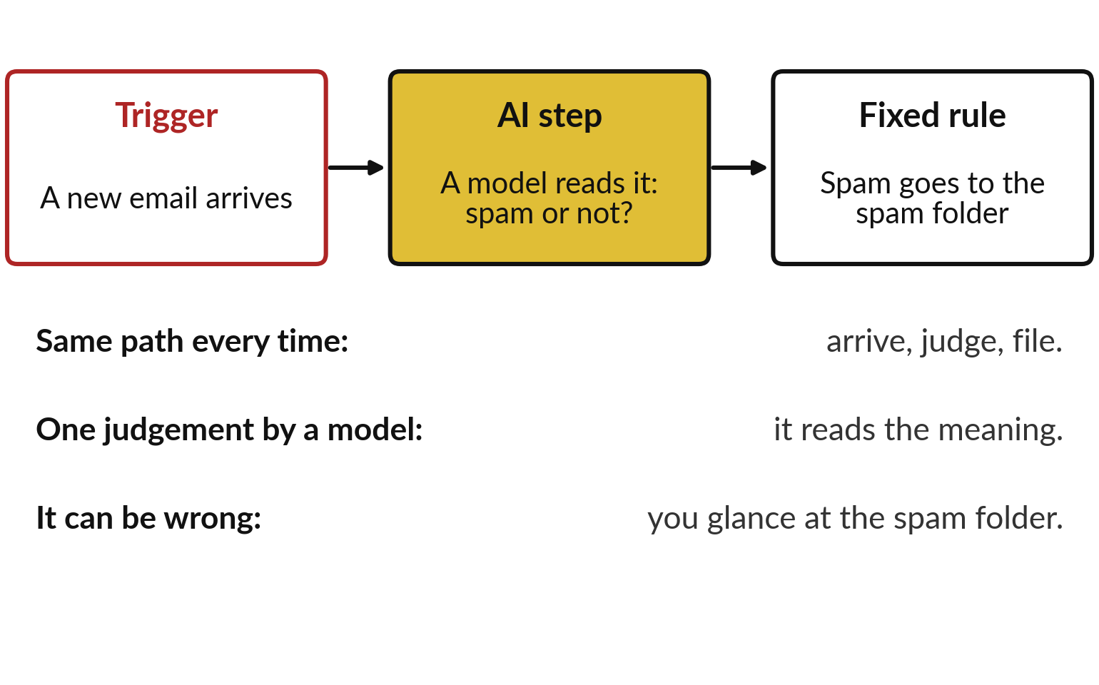
The second kind is an AI step: a model
makes one judgement inside a fixed path
An AI step is one call to a model, placed in a path that never changes.
The path is fixed: arrive, judge, file.
The model judges meaning, as in Session 2.
It can be wrong, so a person checks.
Notes:
Judgement is where the second kind fits. Think of the spam filter in your email. The path never changes: an email arrives, something decides spam or not spam, and a fixed rule files it. The deciding box is a model that reads the meaning of the message. That is classification, as in Session 2: predicting a category.
This one box is an AI step: a single call to a model inside a fixed path. Because models can be wrong, as Session 10 showed, you glance at the spam folder now and then. So what if the path itself has to change from case to case?

Slide 12
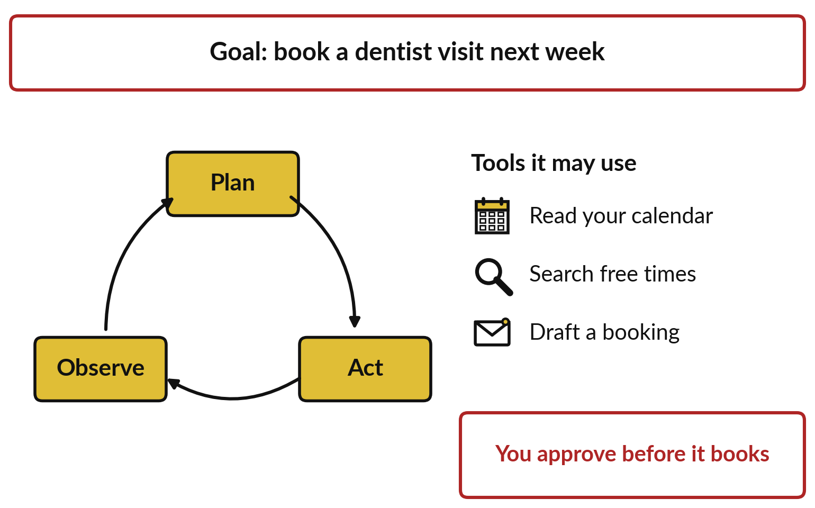
The third kind is an agent: it chooses its
own next step with tools, as in Session 11
An agent gets a goal and tools, and loops: plan, act, observe.
It decides which tool to use next.
Permissions limit what it may touch.
You approve anything that commits you.
Notes:
When the path changes from case to case, you need the third kind, which you met in Session 11: an agent. An agent is an AI model given a goal and tools, and it chooses its own next step in a loop of plan, act and observe. Take booking a dentist visit.
It plans: check my calendar first. It acts by calling a tool and reading the calendar. It observes the free days, then plans again: search the dentist’s free times, then draft a booking. Its permissions limit what it may touch, and human-in-the-loop means you approve before it books.
As Session 0 put it, more freedom needs more guardrails. With three kinds explained, we can compare them.

Slide 13
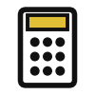



Decide each step with four questions
Question about the step | If yes | Example from the map
Is the answer fixed by clear words or numbers? | Rule-based automation | A payment reference goes to Finance
Does it need the meaning of text, with a quick check? | An AI step | Sort a polite complaint; draft a reply
Does it need several tools and its own next step? | An agent with written permissions | Read a mailbox and draft replies
Does money, trust or law turn on it? | A person (human-in-the-loop) | Approve a credit; send the reply
Ask the questions in this order. Use the first answer that fits.
Notes:
Here are the three kinds side by side, plus the fourth option, a person, as four questions you ask of each step, in order. Is the answer fixed by clear words or numbers?
Then rule-based automation, like the standing order. Does it need the meaning of the text, and can a person check the result quickly?
Then an AI step, like the spam filter. Does it need several tools and a choice of next step?
Then an agent, with written permissions. And whenever money, trust or the law turns on the step, a person decides: human-in-the-loop. Use the first answer that fits, because it is the simplest. Let me apply the four questions to the NVF map.

Slide 14
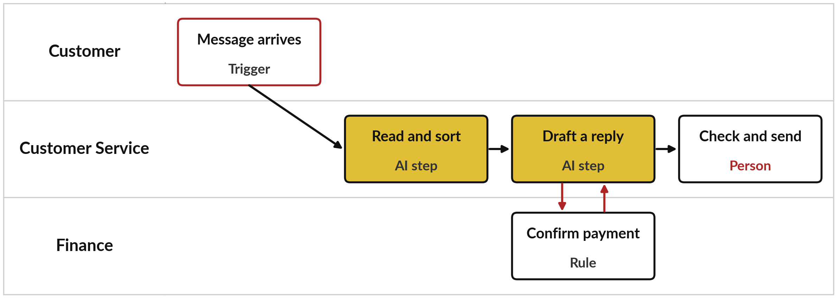
The same map with a choice on every step
Two AI steps, one rule and a person at the end. No step here needs a full agent.
Notes:
Here is the same map with those questions answered on each step. Reading and sorting is an AI step, because meaning matters: a polite complaint has no angry words. Drafting is an AI step too. Confirming a payment is rule-based, because a payment reference is clear. Checking and sending stays with a person, because a reply commits the company.
Notice that no step needs a full agent. Most workflows need one or two AI steps inside a fixed path. An agent earns its place only when the steps change from case to case. Your own inbox may be such a case, so let me sketch one.

Slide 15
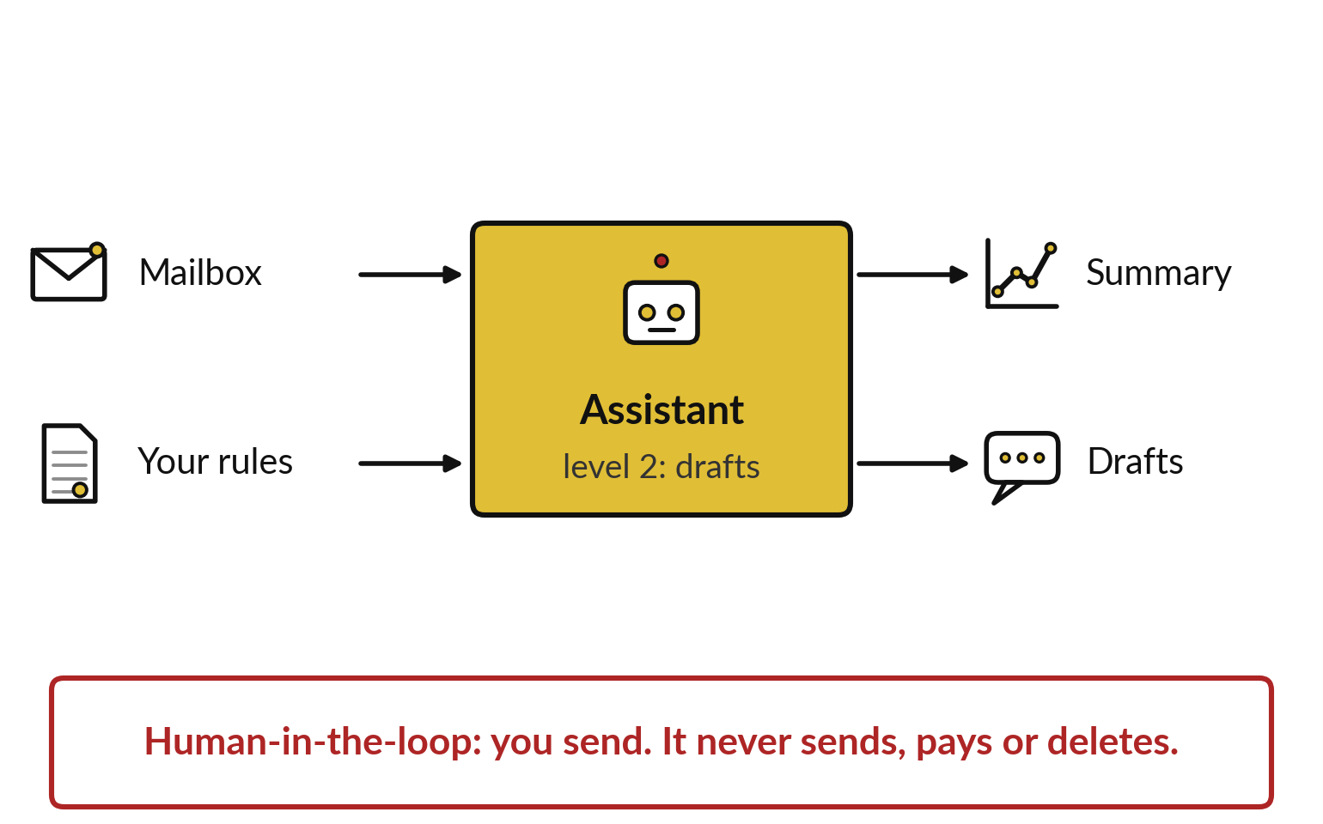
A personal assistant is a small workflow:
sketch its inputs, outputs and approval step
Your own email is a good first workflow to map.
Trigger: every morning at 7.
Permissions: read one mailbox, write drafts.
Human-in-the-loop: you send every reply.
Notes:
Many executives would most like help with their own email, and that is a workflow too, one where an assistant can fit. Sketch it like this. The trigger is the time, every morning at seven. The inputs are one mailbox and your rules, such as who counts as urgent.
The outputs are a summary and draft replies. The permissions are read and draft: autonomy level two from Session 11, where the assistant drafts and you send. It never sends, pays or deletes. If you prefer a work task, map that instead. Rule, AI step or assistant: each choice is a claim until it is tested, so let me test the two cheapest kinds on real messages.

Slide 16
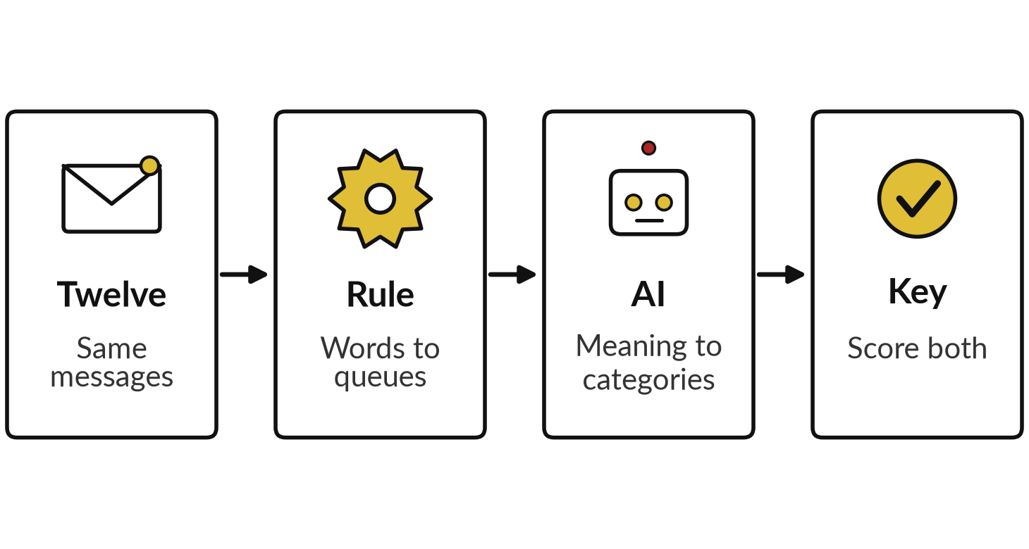
Demonstration: the rule and the AI on
the same twelve customer messages
I will show
Watch for
Which messages fool the rule?
Which one fools the AI?
What does UNSURE cost you?
What was never measured?
Notes:
Here is the test, from records we already have; nothing is rerun. These are twelve customer messages from the NVF practice file, numbered as in the file, M01 to M38. Before anything ran, an answer key was written: the right queue and the right category for each message.
The rule is a keyword router I wrote after reading the messages, so its score flatters it. It sends each message to a queue, the pile for one team, by its words: payment words to Finance, late or delay to Customer Service, the rest to the Sales desk.
The AI reads the meaning and picks a category, or says UNSURE. Watch which messages fool each one.

Slide 17
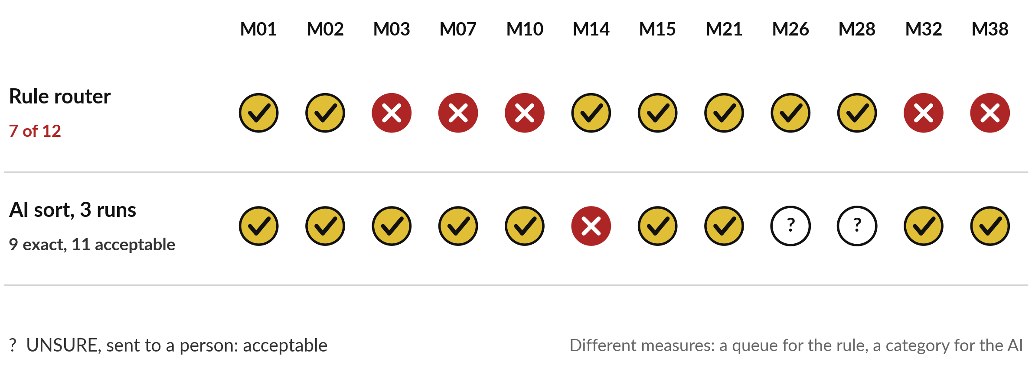
Side by side: the rule routes 7 of 12, the
AI sorts 9 exactly and 11 acceptably
AI: Claude, three fresh sessions, 4 November 2026; not ChatGPT or Gemini. Rule: computed.
Notes:
So which messages fooled the rule, and which one fooled the AI?
The rule sent seven of twelve to the right queue. It fails on M03, wet sugar with no keyword, on M10, a polite complaint, on M32, sarcastic thanks, and on M07 and M38, where late is part of an ordinary order. The AI, in three fresh Claude sessions on the fourth of November, got nine exact, meaning the same category as the key. Two more said UNSURE and went to a person, which we count as acceptable, so eleven of twelve acceptable. It was wrong on M14, a complaint where Finance must act first. Queue and category are different measures, and the time a person takes to check was never measured. The test tells you which kind fits; the next question is what a change is worth.

Slide 18
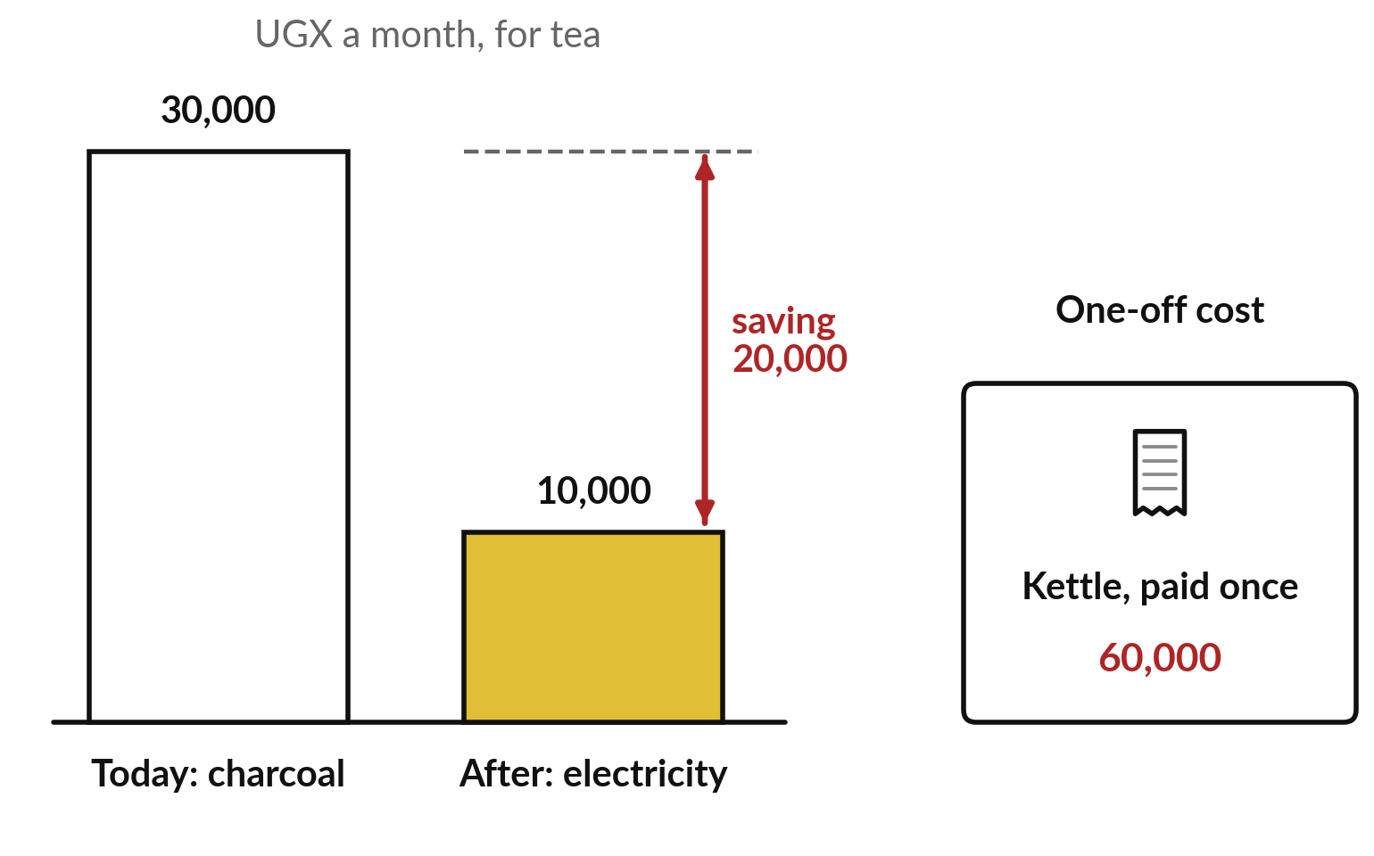
What is a change worth? Start with the
baseline: what tea costs you today, measured
Baseline: how the task performs today, measured before you change anything.
Today: charcoal, 30,000 a month.
After: electricity, 10,000 a month.
Net saving: 30,000 − 10,000 = 20,000 a month.
One-off cost: the kettle, 60,000.
Notes:
To put a value on a change, we start at home with invented round numbers. You make tea on charcoal and think of buying an electric kettle. First the baseline: how things are today, measured before you change anything. Take care: in Session 3 a baseline was a simple model’s score to beat; here it is today’s measured cost or time.
Both are the reference you compare against. You keep the receipts for a month: charcoal for tea costs UGX 30,000. With the kettle you expect electricity of UGX 10,000 a month. That is a running cost, one that repeats every month. The difference, thirty thousand minus ten thousand, is a net saving of UGX 20,000 a month.
The kettle itself costs UGX 60,000, paid once: a one-off cost. So how long until the kettle pays for itself?

Slide 19
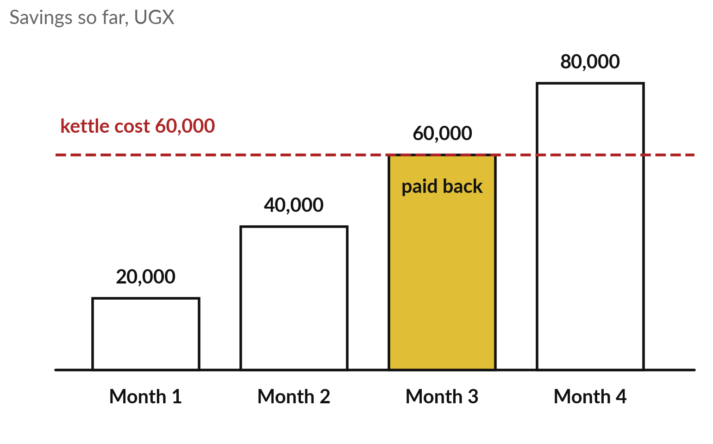
Payback period: count the months
until the savings repay the one-off cost
The kettle has paid for itself by the end of month 3.
Month by month: 20,000, 40,000, 60,000.
Short way: 60,000 ÷ 20,000 = 3 months.
Payback period = one-off cost ÷ net saving a month.
Notes:
To answer that, add up the savings month by month. After month one you have saved 20,000. After month two, 40,000. After month three, 60,000, exactly what the kettle cost. So the kettle has paid for itself in three months. That is the payback period: how long until the savings repay the one-off cost.
Counting works, and division is the short way: sixty thousand divided by twenty thousand is three. In words, payback period equals one-off cost divided by net saving a month. Shorter is better, because the money comes back sooner. But payback stops at month three. What does the whole first year give you?

Slide 20
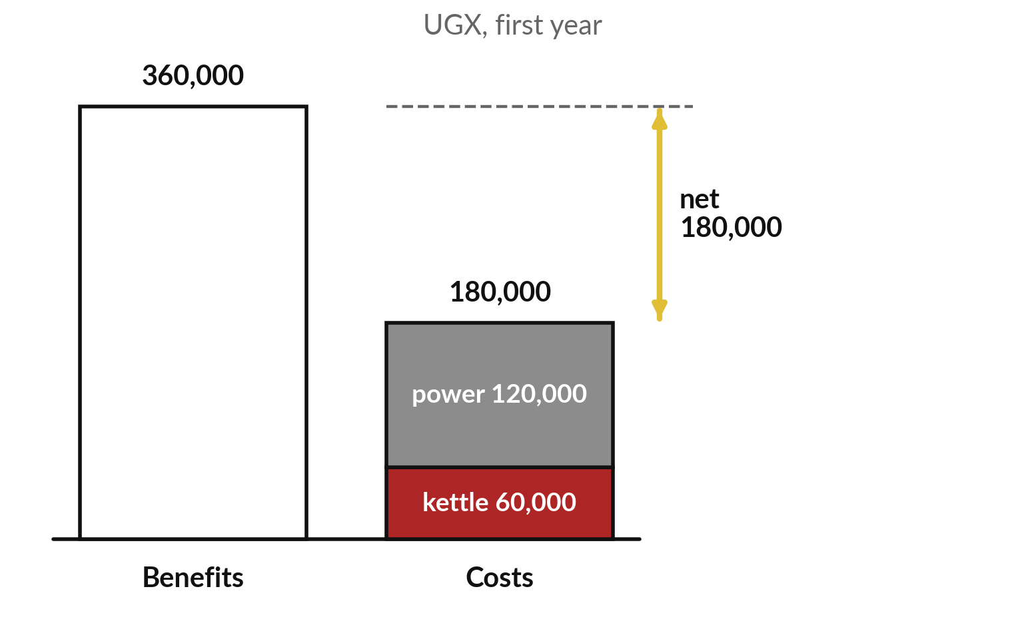
Net benefit and return on investment (ROI):
what the first year gives back for what it costs
First year: benefits 12 × 30,000; costs 60,000 plus 12 × 10,000.
Net benefit = benefits − costs = 360,000 − 180,000 = 180,000.
ROI = net benefit ÷ costs × 100% = 180,000 ÷ 180,000 × 100% = 100%.
Notes:
Net benefit and ROI answer that over a stated period, here the first year. Benefits first: the charcoal you no longer buy, twelve times 30,000, is 360,000. Costs: the kettle, 60,000, plus twelve months of electricity, 120,000, so 180,000 in all. Net benefit is benefits minus costs: UGX 180,000.
Return on investment, ROI, compares that gain with what you spent: net benefit divided by costs, times one hundred percent. One hundred and eighty thousand divided by one hundred and eighty thousand is one, so one hundred percent: every shilling spent came back, plus one more. Zero percent means you only broke even. Now the same method at work.

Slide 21
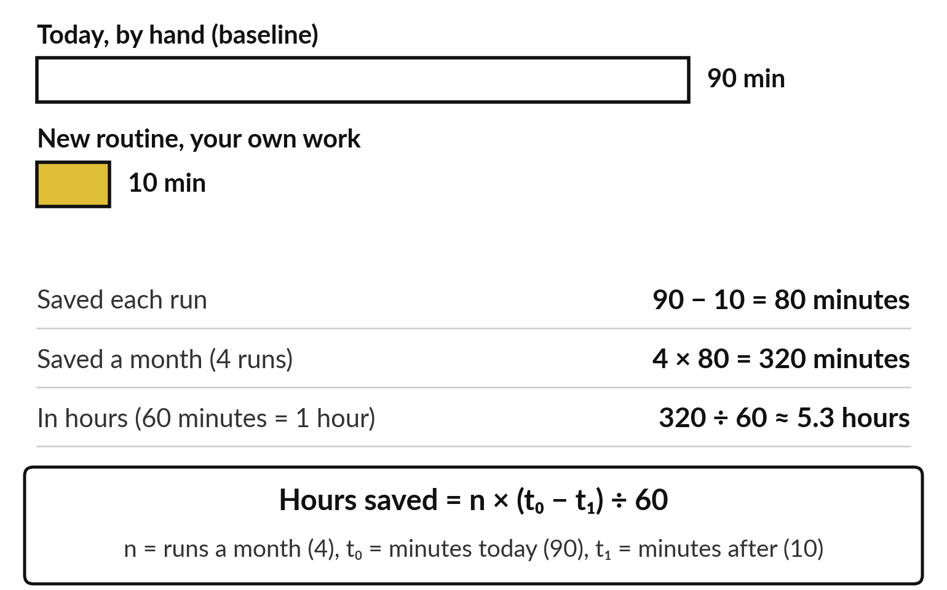
At work the saving is often time: hours
saved on the Monday sales email
Baseline 90 minutes a run; plan 10 minutes. Invented NVF plan numbers.
With 20 minutes of review a run: 4 × 60 = 240 minutes, 4 hours.
Review time is priced as a cost.
Notes:
At work the first saving is usually time, and we build it the same way. Take the Monday sales email at Nile Valley Foods, a weekly summary of sales sent to managers. The baseline: today it takes ninety minutes. The plan for the new routine is ten minutes of your own work. So each run saves ninety minus ten, eighty minutes. It runs four times a month: four times eighty is 320 minutes. Divide by sixty, because an hour has sixty minutes: about 5.3 hours. The formula says the same: hours saved equals n, the runs a month, times t nought minus t one, minutes today minus minutes after, divided by sixty.
A person also reviews each run for twenty minutes, so the real saving is four hours. The workbook prices that review as a cost.

Slide 22
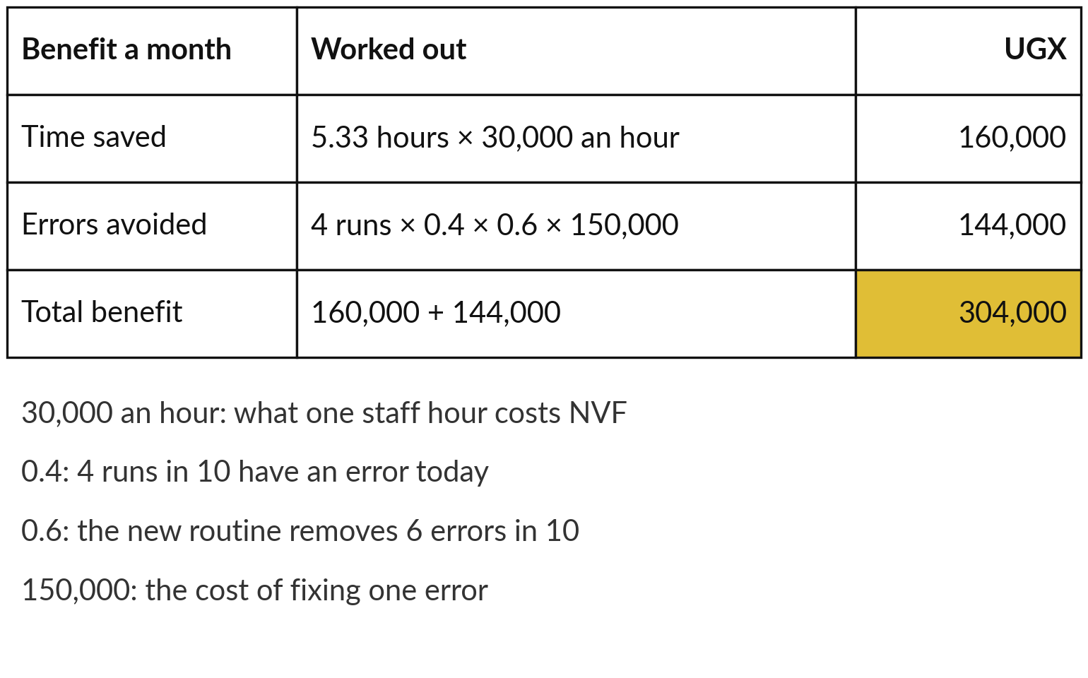
Turn the hours into shillings: the NVF
benefits come to UGX 304,000 a month
Two benefits, each worked from the workbook inputs.
Time saved = hours × hourly cost.
Errors avoided = runs × share with an error × share removed × cost of one error.
Notes:
Hours persuade you; shillings persuade whoever holds the budget, so the Business Case Workbook prices each hour. The hourly cost is what one staff hour costs the company: pay plus employer contributions, divided by hours worked, about UGX 30,000 at NVF. Time saved: 5.33 hours times 30,000 is 160,000 a month.
The second benefit is errors avoided, built like the expected cost of Session 10, a share times a cost. Today four runs in ten contain an error, a share of 0.4, so four runs a month bring 1.6 errors on average. The plan says the new routine removes six errors in ten, 0.6.
One error costs 150,000 to fix. So four times 0.4 times 0.6 times 150,000 is 144,000. Total benefit: 304,000 a month, all invented plan values. Now the costs.

Slide 23
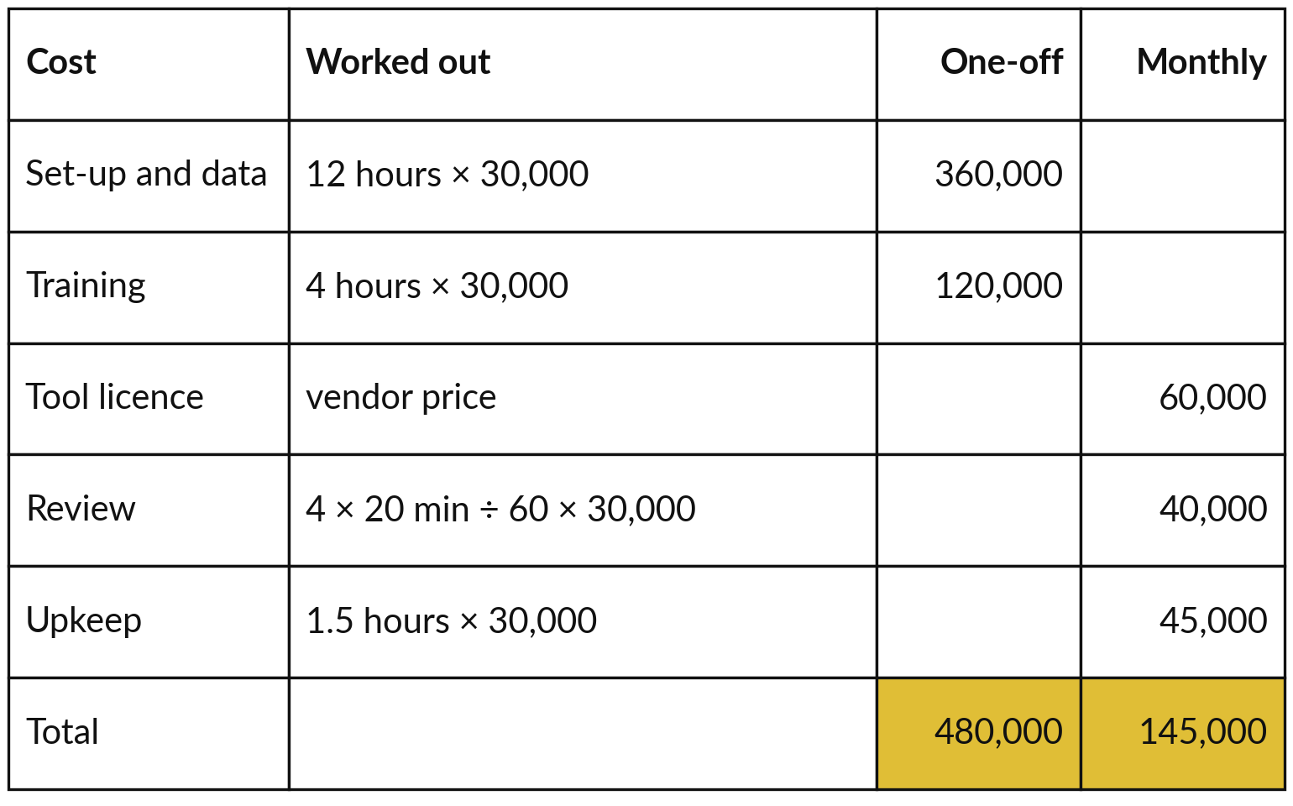
The NVF costs: UGX 480,000 once,
then UGX 145,000 every month
Like the kettle: a one-off cost and a running cost.
One-off: 16 hours × 30,000 = 480,000.
Monthly: 60,000 + 40,000 + 45,000 = 145,000.
Notes:
Just as the kettle had a price paid once and electricity every month, the workbook splits the costs in two. One-off costs: twelve hours to set up and prepare the data, and four hours of training, sixteen hours at 30,000, UGX 480,000. Monthly running costs: the tool licence, 60,000, quoted by the vendor; review, four runs times twenty minutes, divided by sixty and priced at 30,000 an hour, 40,000; and upkeep, an hour and a half at 30,000, 45,000.
That is 145,000 a month. Review is priced here, so it is never treated as free. Now we have both sides, and the kettle formulas do the rest.

Slide 24
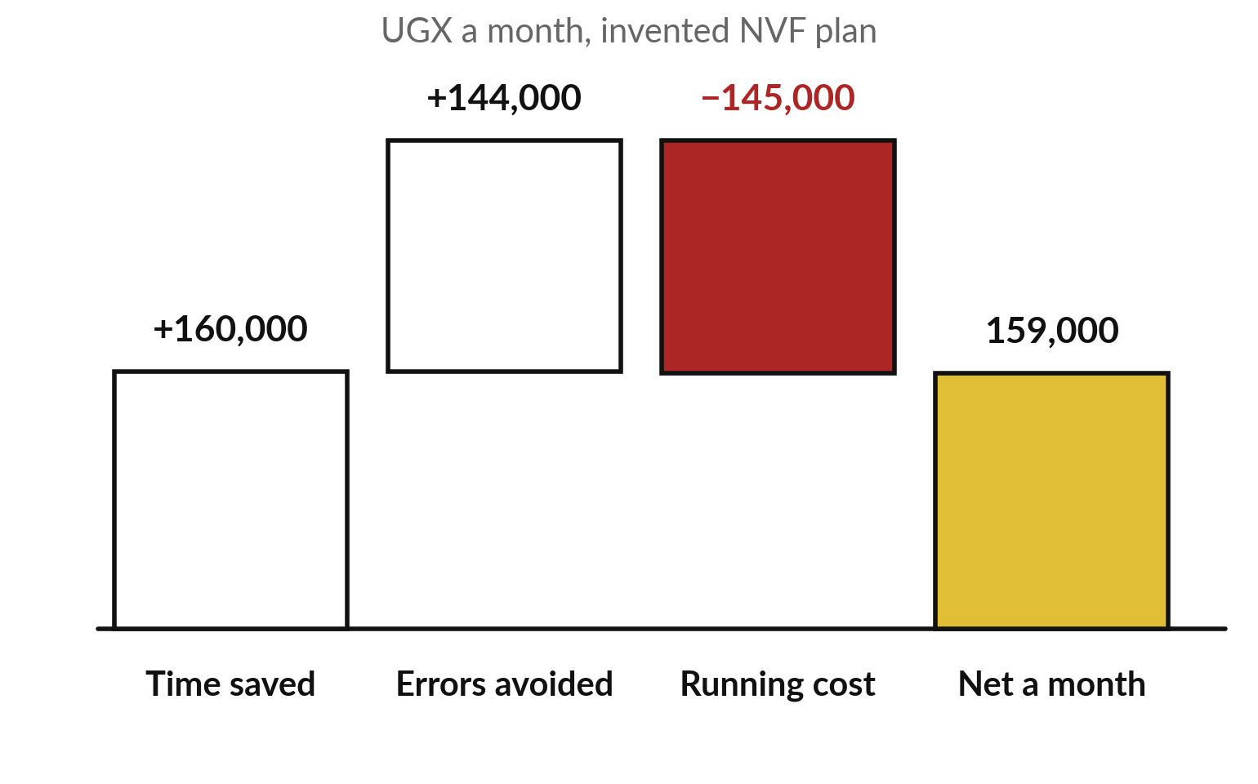
The NVF result: net UGX 159,000 a month,
payback 3.0 months, first-year ROI 64%
The same formulas as the kettle, with NVF numbers.
Net a month: 304,000 − 145,000 = 159,000.
Payback: 480,000 ÷ 159,000 ≈ 3.0 months.
First year: 1,428,000 ÷ 2,220,000 × 100% ≈ 64%.
Notes:
Net a month is benefit minus running cost: 304,000 minus 145,000, UGX 159,000. Payback period is one-off cost divided by net a month: 480,000 divided by 159,000, about 3.0 months. For the first year, net benefit is twelve times 159,000, which is 1,908,000, minus the one-off 480,000: UGX 1,428,000.
Costs for the year are 480,000 plus twelve times 145,000, so 2,220,000. ROI is 1,428,000 divided by 2,220,000, times one hundred percent: about 64 percent. It is lower than the kettle because the running costs are large. These are plan numbers. After a five-minute break, you build your own.

Slide 25
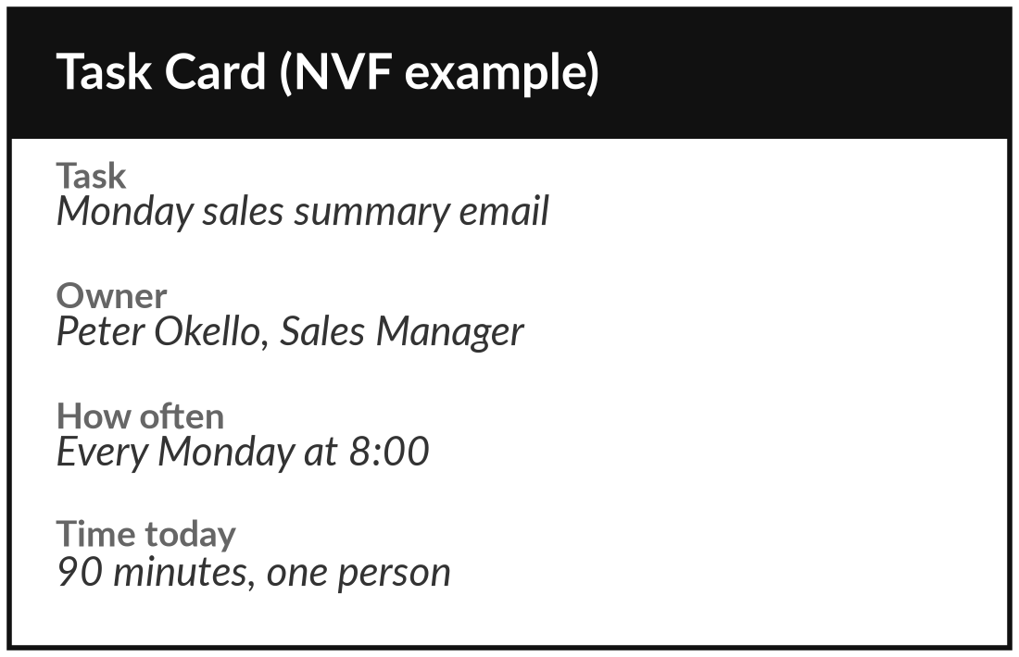
Map your workflow: trigger,
steps, handoffs and check
15 minutes
Your own workflow
Draw one repeated task in lanes, from trigger to check.
Pick one weekly task. Unsure? List options on the Use-Case Scorecard.
Draw one lane for each person or system.
Write the trigger, then each step in a box.
Mark every handoff in red and the check in gold.
You keep: A one-page map of your workflow with the handoffs marked.
Notes:
Welcome back. From here to the decision the work is yours, and I am at your side. Pick one task you do every week. It can be a work task, such as the monthly report, supplier invoices or leave requests, or the summary of your own email. Draw a lane for each person or system involved.
Write the trigger, then each step in a box, as we did for the tea. Mark every handoff in red and the check in gold. If you cannot choose, list a few on the Ten tasks sheet of the Use-Case Scorecard: task, owner, how often, kind of work and minutes each time.
Then fill the top of a Task Card. You have fifteen minutes.

Slide 26
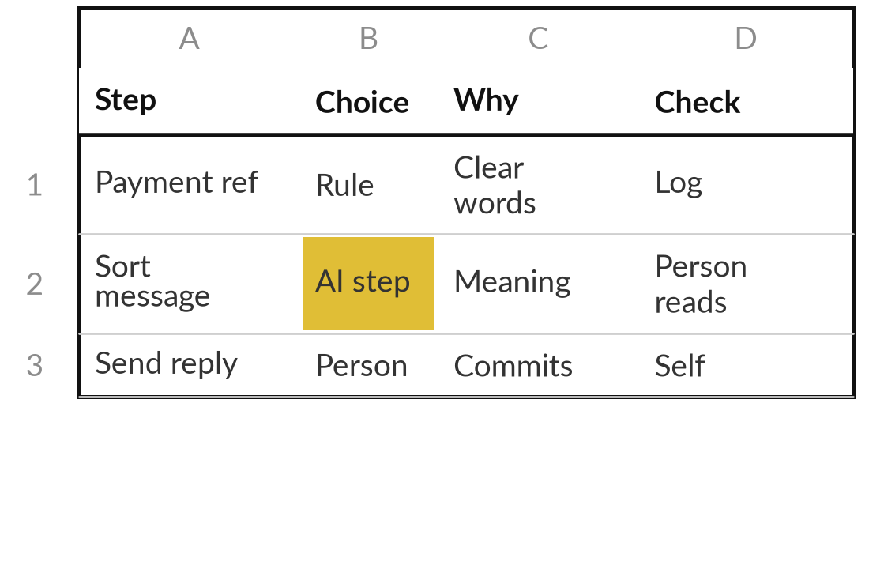
Decide each step: rule-based
automation, AI step, agent or person
15 minutes
Your own workflow
Tag every box on your map with one choice and one reason.
Ask the four questions for each step, in order.
Write rule, AI step, agent or person in the box.
For each AI step, write how a person checks it.
Circle the step that costs the most time.
You keep: Your map with a choice, a reason and a check on every step.
Notes:
With your map drawn, the second step is to decide, using the four questions from earlier. For every box on your map, ask them in order. Clear words or numbers: rule-based automation. Meaning with a quick check: an AI step. Several tools and its own next step: an agent.
Money, trust or law: a person. Write the choice and one reason in the box. For every AI step, write how a person checks it, because Session 10 showed us that models fail. Then circle the step that costs you the most time. That is usually where to start. You have fifteen minutes, and I keep coming round.

Slide 27
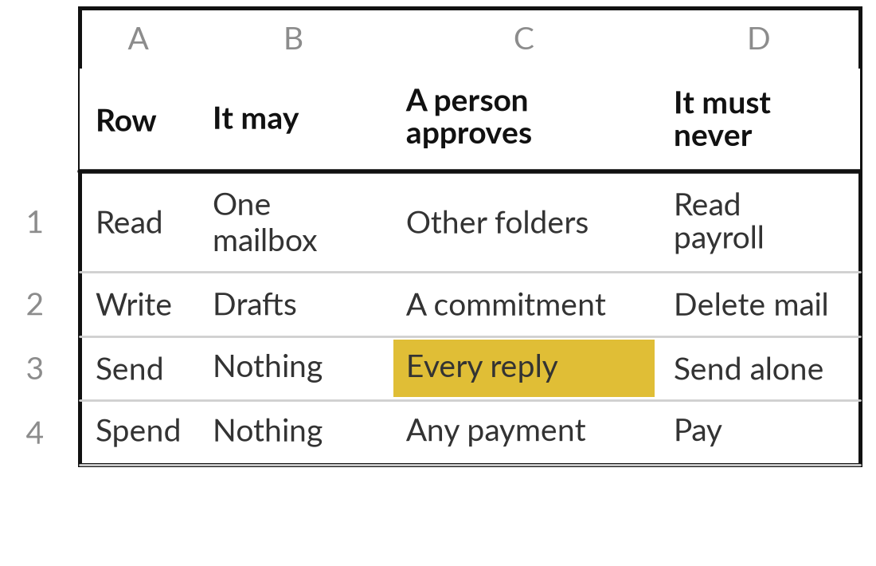
Sketch your personal assistant with
its permissions and approval step
10 minutes
Your own workflow
Draw one assistant for your workflow: inputs, outputs, permissions, approval.
Write its trigger and its inputs.
Write the outputs it hands to you.
Grant the fewest permissions that work.
Name who approves and the off switch.
You keep: A sketch of one assistant with its four permission rows.
Notes:
Some of your boxes may now say AI step or agent, and this third step, ten minutes, turns them into an assistant sketch. Write its trigger and its inputs, then the outputs it hands to you. Grant the fewest permissions that still do the job, the principle of least privilege, using the four rows of the Tool Boundary Sheet: read, write, send and spend.
Name the person who approves and the off switch. If no step in your workflow suits an assistant, write that down. It is a useful finding. A rule or one AI step may be all you need. Either way, the next question is what it is worth.

Slide 28
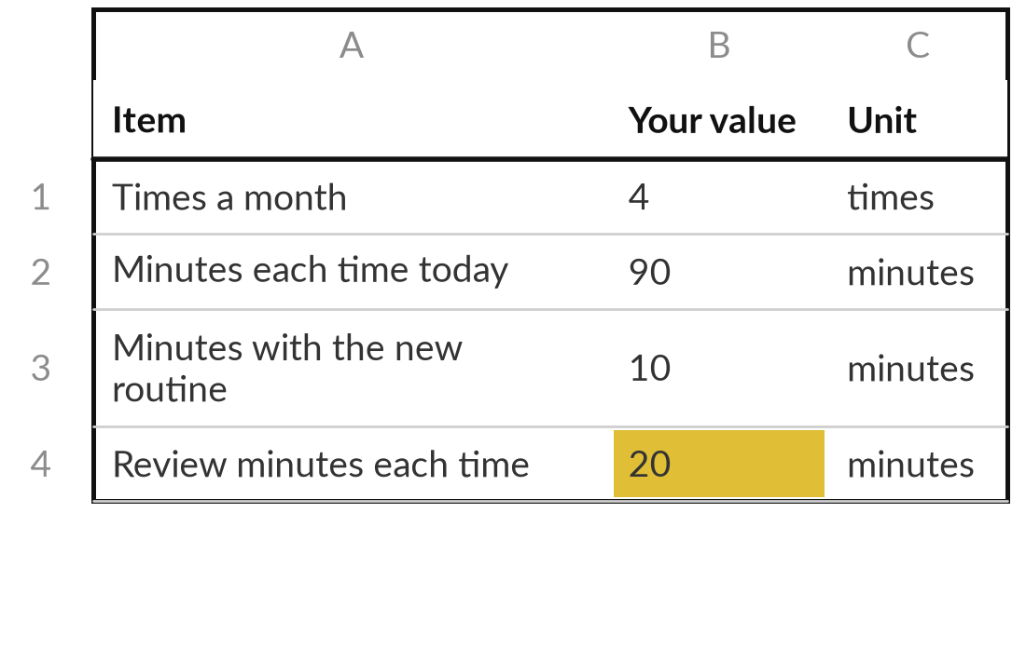
Estimate the hours saved and enter
them in the Business Case Workbook
15 minutes
Your own workflow
Fill the Inputs sheet for your workflow and read the hours saved and the payback period.
Type how often, minutes today and people involved: your baseline.
Type minutes with the new routine and review minutes.
Add your hourly cost: pay plus contributions, over hours worked.
Mark each figure E for estimate or M for measured.
You keep: Your Inputs sheet filled, with the hours saved and every figure marked E or M.
Notes:
To put a number on it, the last step, fifteen minutes, is the workbook. Open the Business Case Workbook and go to the Inputs sheet. Type over the grey example: times a month, minutes each time today and people involved, which together are your baseline. Then minutes with the new routine and review minutes.
Never set review to zero. Work out your hourly cost: pay plus employer contributions and benefits, divided by hours worked. Mark each figure E if it is your estimate and M if you measured it. The Benefits and Result sheets then show the hours saved, the net a month and the payback period. I come round to check your figures with you.

Slide 29




Plan against measurement: four
numbers to record for four weeks
Minutes each run, with the new routine, including review.
Errors found in each run, and what each cost.
Cases sent to a person, such as UNSURE.
Your stop rule: the number at which you revise or stop.
Notes:
With most figures marked E, your estimate is a plan. Before anyone spends money, measure four weeks of the real task with the new routine, using four numbers, so the baseline and the saving become measured. Minutes each run, including the review. Errors found in each run, and what each cost.
Cases sent to a person, such as the UNSURE answers we saw from the AI. And your stop rule, written now while you are calm: for example, revise if review rises above thirty minutes a run. The workbook’s Stop rules sheet has examples. A measured result that beats the plan is your strongest case. With that in hand, you are ready to choose.

Slide 30
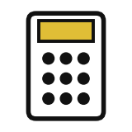



Decision: what will you build or test first?
For your mapped workflow, which first step do you choose?
A rule
One AI step
An assistant at level 2
Measure first
Clear words or numbers: automate a fixed rule. Cheap and easy to explain.
Meaning matters and a person checks each result.
Several steps; drafts only; you approve.
No baseline yet. Time four weeks, then decide.
Write the step, your choice and the number that will tell you it worked.
Notes:
Your map, your choices, your sketch and your estimate are all on the desk, so decide. For your mapped workflow, what do you build or test first?
Rule-based automation, when the words or numbers are clear: cheap to build and easy to explain. One AI step, when meaning matters and a person checks each result. An assistant at autonomy level two, when several steps change from case to case, with drafts only and you approving. Or measure first, when you have no baseline yet. Say your choice aloud, then write the step, the choice and the number that will show it worked.

Slide 31
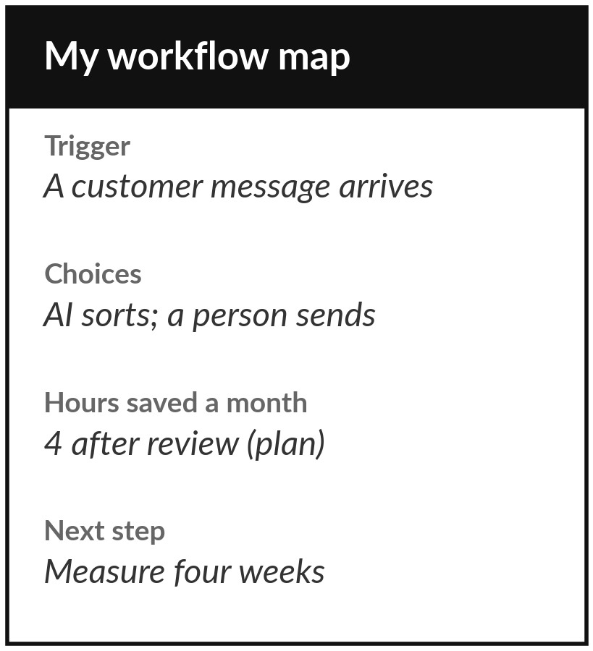
Keep your map and your hours-saved estimate
What you keep from today
Your mapped workflow, the choice for each step, your assistant sketch, and the baseline and hours-saved estimate in the Business Case Workbook.
Our question today
Which of my tasks should be a rule, an AI step or an agent?
Next session
Session 13: Governance and buying (practical). Bring your map; we write the policy and the vendor questions around it.
Notes:
Your decision and its number close the practical work for today. You keep your map, your choices, your assistant sketch and the workbook with your estimate. Your estimate is a plan. Before you trust it, measure four weeks of the real task to replace estimated figures with a measured baseline.
In Session 13, our second practical, we write the policy and vendor questions around your map, so bring it with you.
We began with this question: Which of my tasks should be a rule, an AI step or an agent? Before you go, say in one sentence what you can now say about it.

